Slide 1


Web Programming
By Tommy Lindh & Adam Zetterling
Notes:
Först några minuter om Lundalogik.

Slide 2

Agenda
Purpose, goal and outcome of the day
Content
Certification test
Notes:
AGENDA

Slide 3
Purpose, goal and outcome of the day
To expand your knowledge around web programming beyond the limited scope of Lime Bootstrap.
purpose
Every participant should feel comfortable to tackle a somewhat complex web programming case outside of Lime CRM, for example in the form of a public input form.
goal
You should have an idea on how to structure a web project, what some of the more modern Javascript features are and how to use them. You should also be aware of some of the most common pitfalls when working with Html/Javascript/CSS.
Outcome of the day
Notes:
Make sure to gather the expectations of the course from the participants.
Be clear of which of these you hopefully will fulfil, and if any, also point out those that you will not be able to cover in this session.

Slide 4
Agenda
Purpose, goal and outcome of the day
Content
Certification test
Notes:
AGENDA

Slide 5

Web programming
HTML
CSS
Javascript

Slide 6

HTML(5)
Hyper Text Markup Language
Hypertext…?
What’s up with the 5?
”Do we support HTML5”?

Slide 7

CSS(3)
Cascading Style Sheets
Changes styling of markup documents
Uses selectors
Type
Class
Id

Slide 8

Some important technical terms
DOM
Document Object Model
Tree structure representation of (e.g.) HTML
Provides events
HTML attribute ”class”
Selector (.)
Mostly used for styling
HTML attribute ”id”
Selector (#)
Must be unique across the document
Used for styling and in Javascript

Slide 9
CSS (continued)
Specificity
Type
Class
Id
Inline (do not use!)
!important (avoid)

Slide 10
Specificity example #1
<div id=”container”>
<span>Woop</span>
<span>deee</span>
<span>doooo!</span>
</div>
div#container span{
color: #454545;
background-color: #FFF;
}
Let’s style this tiny HTML document.
How about making the text a nice subtle dark gray, and ensure that the background stays white?

Slide 11
Specificity example #2
<div id=”container”>
<span class=”active”>Woop</span>
<span>deee</span>
<span>doooo!</span>
</div>
div#container span{
color: black;
background-color: white;
}
Someone wanted you to add some flair to the first span and suggest you use the class ’active’ for this.
How do we make the text bold and the background colour a bit darker?
div#container span.active{
font-weight: bold;
background-color: #DEDEDE;
}

Slide 12

Javascript
Scripting language
Introduced by Netscape (1995)
Mimicked by Microsoft (JScript)
Standardised as Ecmascript (ES)

Slide 13

Javascript cont. – The jungle
ES versions
ES5.1
ES6 (ES2015)
ES7 (ES2016)
ES8 (ES2017)
Libraries
JQuery
Knockout
React
Angular
Angular2
Meteor
…

Slide 14
Ecmascript
Versions of ”Javascript”
Ecmascript is not Javascript
Javascript is a dialect
New cool features
Standardized

Slide 15
ES6 important features
String templates
Fat arrow functions
Default parameters
Classes
Block scoped constructs
Destructuring
Promises
Import/Export

Slide 16
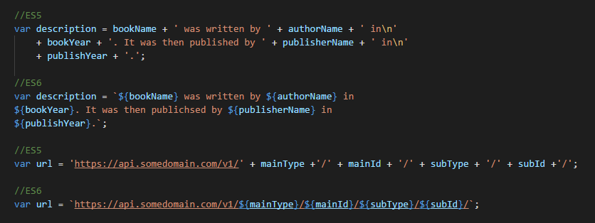
String templates
Tired of concatenating strings?
What about multi-line strings?
Never fear, ES6 comes to the rescue!
Denoted with ``

Slide 17
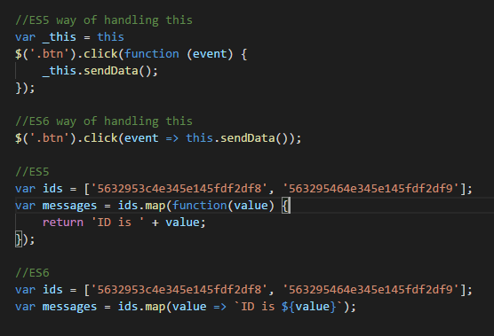
Fat arrow functions
Handles this ”as expected”
Same as the context of the function
Enables implicit returns
Notes:
Note that you can have a body in Fat arrow functions aswell. (Maybe add an example)

Slide 18
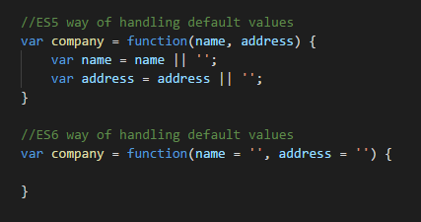
Default parameters
”Piping” no longer necessary
Problem with parameter = 0
This was largely ignored…!?

Slide 19
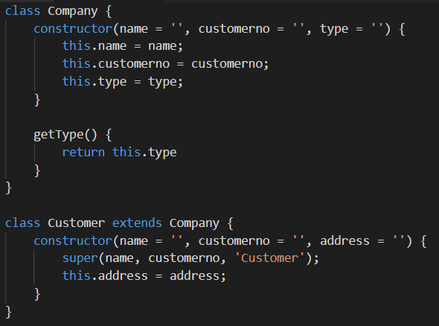
Classes
ES5 has no good way to handle classes
ES6 does!
Constructors
Member functions
Get/Set
Class inheritance through extends

Slide 20
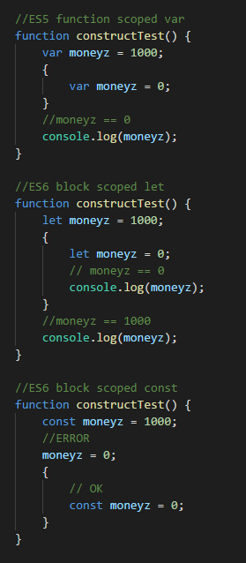
Block scoped constructs
Only var exists in ES5
ES6 introduces two new
let
const
Block scoped as opposed to function scoped
const is immutable
Cannot be re-assigned within its scope.

Slide 21
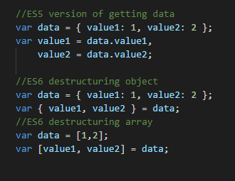
Destructuring
Way of extracting data from objects/arrays
Comes from the way we construct objects and arrays

Slide 22
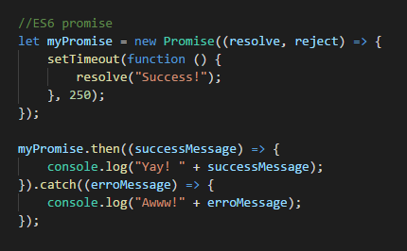
Promises
A Promise is a proxy for a value that may not yet have been calculated
A Promise can be in the following states:
Pending: value is being calculated
Fulfilled: value has been calculated
Rejected: calculation failed
Prevents complex nested callback structures

Slide 23
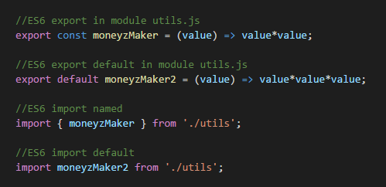
ES6 modules (Import/Export)
A module is just a piece of javascript code in its own file.
Simple way of splitting code
Easy to maintain
Easy to develop
Easy to reuse
Export shares parts of a module with the outside world
Import brings parts of modules into the scope of your current module.

Slide 24

Web application (simplified)
HTML file
Javascript file(s)
Loaded through the html file
CSS file(s)
Loaded through the html file

Slide 25
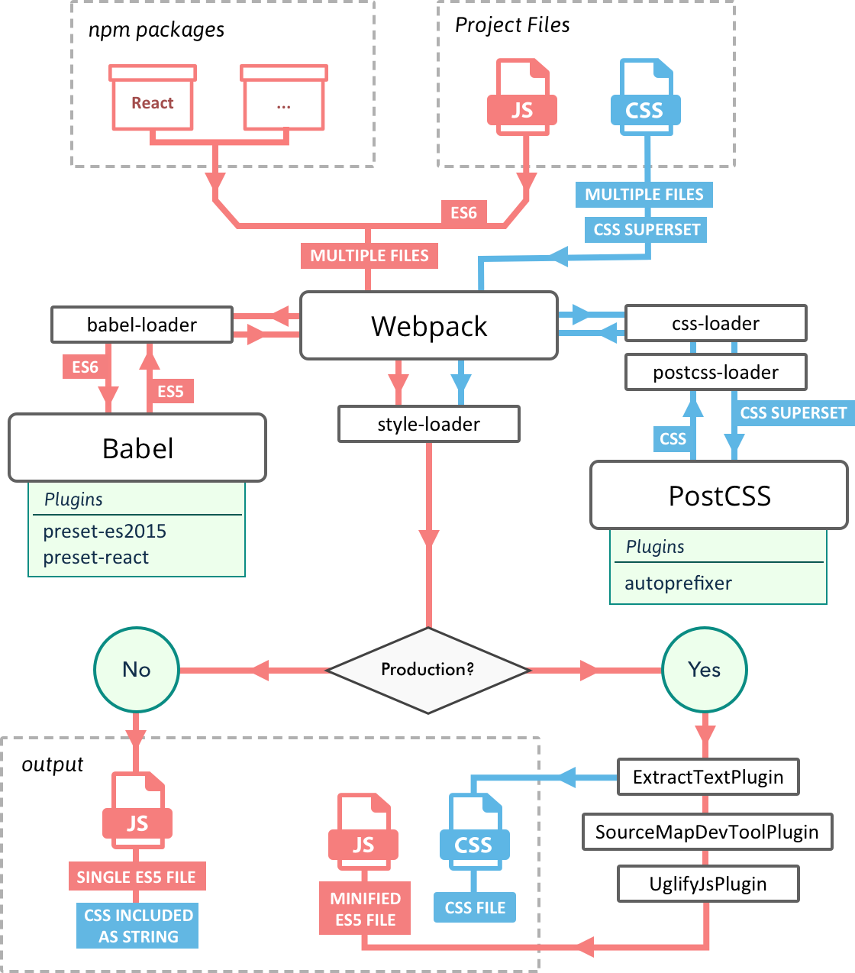
Web application in reality

Slide 26

Node JS
Javascript server framework
Enables javascript to run server side
Serving webapps
Npm
Etc.

Slide 27

Npm – Node Package Manager
Package manager for Javascript libraries
World’s largest software registry
Think ”pip” or ”lip”
Dependencies work like magic

Slide 28

Working with REST
ZzZzZzzzZzzzz
HTTP(S) Requests
Methods:
GET
POST
PUT
DELETE
Asynchronous (preferably)
Multiple ways in Javascript
JQuery
Axios
Fetch
Etc.
JSON/XML

Slide 29
Agenda
Purpose, goal and outcome of the day
Content
Certification test
Notes:
AGENDA

Slide 30
Test time!
Create a weather forecast app
Pair up!
Clone the git repository for the assignment:
git clone https://github.com/Lundalogik/lca-web-programming-assignments.git
Follow the instructions in the README.md

Slide 31



Wrap up
What have you learned today?
Notes:
Vi har en stor kompetens i att införa system.
Vi har totalt infört CRM hos mer än 6 000 företag och varje år levererar vi ca 700 nya införanden.
Vi lär av våra misstag och får chansen att hela tiden förbättra vår metodik.
Vi har relevanta referenser, många med fokus på sälj, kampanjer och ärendehantering.

